Slide 1



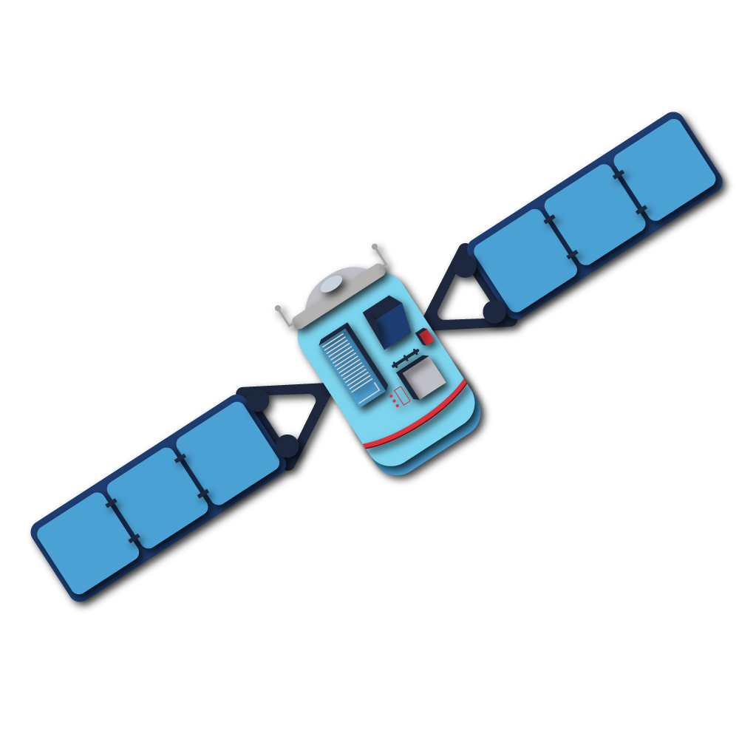



MAE FAH LUANG UNIVERSITY
CHAPTER 1
CHAPTER 1
Types and Feature
of Satellites
ประเภทและคุณสมบัติของดาวเทียม
Landsat-8 & Sentinel-1 & Sentinel-2
Center of Excellence in AI and Emerging Technology

Slide 2

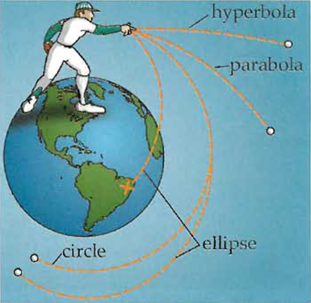


What is an orbit?
Orbit is the path of movement of one object around another object. Under the influence of gravity, the nature of orbital movement depends on the speed of the object and the gravitational force of the star that the object moves around. which has movement characteristics according to the form of a conic section in one of 4 forms of conic sections, namely circle, ellipse, parabola or hyperbola only.
Fun Facts
Center of Excellence in AI and Emerging Technology

Slide 3
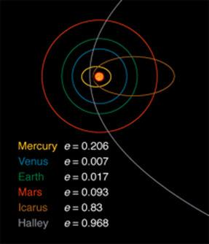
Elliptical Orbit
An elliptical orbit is an orbit in which an object moves around another object under the influence of gravity in an elliptical manner. That is, the orbit has an eccentricity between 0 – 1 according to the eccentricity of the orbit. An orbit with an ellipticity close to 0 is an orbit that is close to a circular orbit. For example: The orbit of the NAPA-1 satellite has an orbital eccentricity of only 0.0004, making the orbit similar to a circular orbit.
https://www.windows2universe.org/the_universe/uts/kepler1.html
Center of Excellence in AI and Emerging Technology

Slide 4
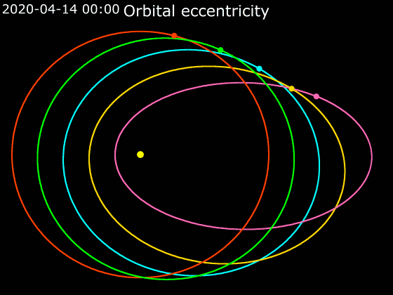
Circular Orbit
A circular orbit is an orbit in which an object moves around another object under the influence of gravity in a completely circular manner, i.e. the orbit has eccentricity is equal to zero. The radius of the orbit is constant, causing the object to move at a constant speed throughout its orbit.
https://en.wikipedia.org/wiki/Elliptic_orbit#/media/File:Animation_of_Orbital_eccentricity.gif
Center of Excellence in AI and Emerging Technology

Slide 5
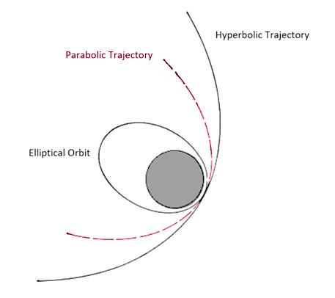
Parabolic Trajectory
Parabolic Trajectory is an open orbit. It is not closed like a circle or ellipse. It is characterized by an orbit that is somewhere between an elliptical orbit and a hyperbolic orbit. It has an orbital eccentricity equal to one, which means that the object orbits at an escape velocity that allows the object to move away from the influence of the star's gravity.
https://history.nasa.gov/conghand/traject.htm
Center of Excellence in AI and Emerging Technology

Slide 6
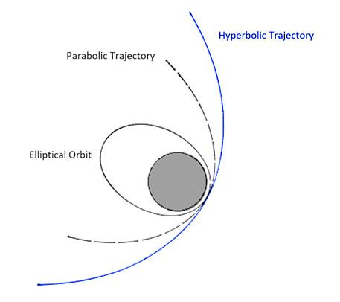
Hyperbolic Trajectory
An elliptical orbit is an orbit in which an object moves around another object under the influence of gravity in an elliptical manner, that is, the orbit will have an ellipticity between 0 – 1 according to the eccentricity of the orbit. An orbit with an ellipticity close to 0 is an orbit that is close to a circular orbit. For example: The orbit of the NAPA-1 satellite has an orbital eccentricity of only 0.0004, making the orbit similar to a circular orbit.
https://history.nasa.gov/conghand/traject.htm
Center of Excellence in AI and Emerging Technology

Slide 7
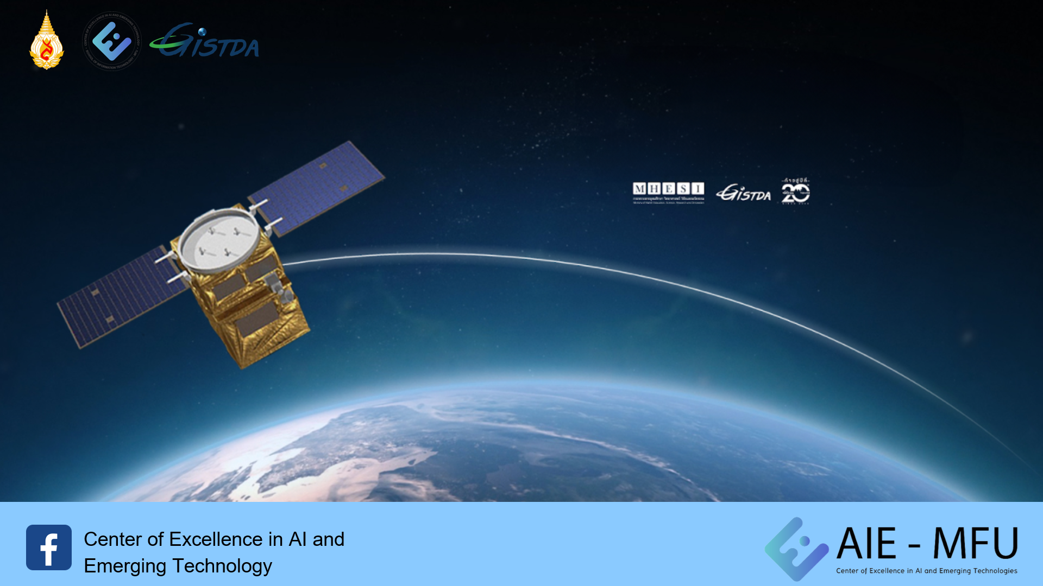
How does a satellite move?
Center of Excellence in AI and Emerging Technology

Slide 8

Satellite orbit
There are 2 types of satellite orbit
Sun-synchronous orbit
Equatorial orbit
Center of Excellence in AI and Emerging Technology

Slide 9
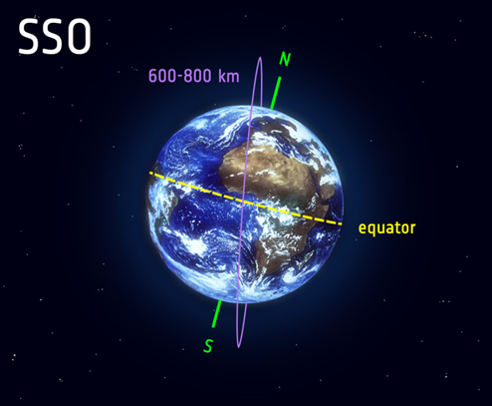
Sun-synchronous orbit
Sun Synchronous Orbit (SSO) is a type of orbit of the polar orbit where the satellite passes over the polar region in the same position at all times relative to the Sun. This allows the satellite to orbit over the same location at the same local time, for example, orbiting over Paris every day at exactly noon.
The ability for satellites to orbit and look at their position on Earth as if they were always at the same time of day. This causes the angle at which the sunset light hits the earth on each day to be approximately the same. This is useful for comparing changes in satellite images. and can be applied in a variety of ways, such as viewing changes in resources Monitoring wildfires and floods to predict future trends
Satellites in SSO orbit are usually at an altitude of about 600 to 800 kilometers and move at a speed of about 7.5 kilometers per second.
Center of Excellence in AI and Emerging Technology

Slide 10
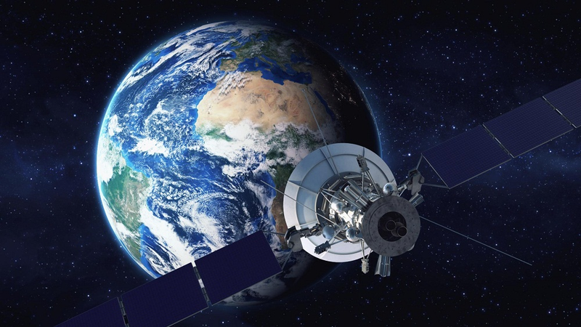
Equatorial orbit
It is a horizontal orbit. It has a circular orbit that orbits horizontally with the equator. If orbiting at an altitude of 36,000 kilometers from the earth It will move at the same speed as the earth rotates around itself. That is, it takes 24 hours/cycle to orbit as if the satellite’s position is constant at all times, called a "Geostationary orbit” and satellites orbiting in this orbit are called "Geostationary satellite” which are mostly meteorological satellites and communication satellites such as Thaicom satellites.
Center of Excellence in AI and Emerging Technology

Slide 11
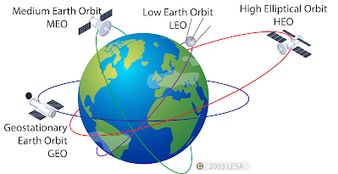
Satellite orbital level
Can be divided into 4 main cycles
Low Earth Orbit (LEO) is an orbit around the Earth with an altitude of 80 - 2,000 kilometers above the Earth.
Medium Earth Orbit (MEO) is an orbit around the Earth with an altitude of 2,000 - 35,786 kilometers above the Earth.
Orbit relative to the Earth (Geosynchronous Orbit : GSO) is an orbit around the earth with a complete orbital period of 24 hours, which corresponds to an altitude of 35,786 kilometers from the earth. The orbit is fixed in the sky. (Geostationary Orbit: GEO) is an orbit in orbit relative to the Earth that has no orbital inclination.
High Earth Orbit (HEO) is an orbit around the Earth with an altitude of more than 35,786 kilometers above the Earth.
Center of Excellence in AI and Emerging Technology

Slide 12

Passive and Active Satellites
Can be divided into 2 types
Passive Satellite uses solar energy. It will receive the reflection values emitted by the sun. When the sun releases light energy that hits an object, it will be reflected back to the satellite receiver (Sensor) and will be able to collect data well only during the daytime.
Active Satellite will have its own power source for transmitting energy waves to objects and reflecting them back to the receiver and it can operate at any time
Center of Excellence in AI and Emerging Technology

Slide 13
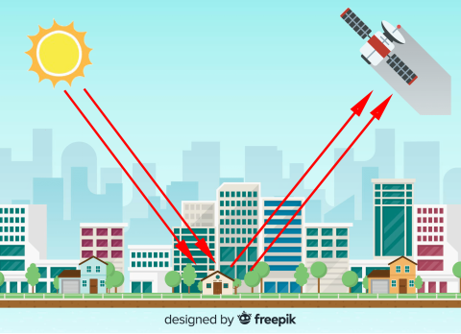
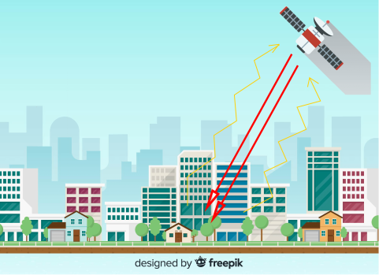
Comparison of Passive and Active Satellite Operation
Passive Satellite
Active Satellite
Center of Excellence in AI and Emerging Technology

Slide 14
Landsat-8 satellite
Type of wave range | Landsat 8 Data
 | Wave range size (µm) | Detail of picture (meter)
1.Coastral Aerosol | 0.43 – 0.45 | 30
2. Range of vision: Blue | 0.45 – 0.51 | 30
3. Range of vision: Green | 0.53 – 0.59 | 30
4. Range of vision: Red | 0.64 – 0.67 | 30
5.Near Infrared NIR | 0.85 – 0.88 | 30
6. Short-wavelength infrared 1: SWIR 1 | 1.57 – 1.65 | 30
7. Short-wavelength infrared 2: SWIR 2 | 2.11 – 2.35 | 30
8.Panchromatic | 0.50 – 0.68 | 15
9.Cirrus | 1.36 – 1.38 | 30
10.Thermal Infrared – TIRS 1 | 10.60 – 11.19 | 100
11.Thermal Infrared – TIRS 2 | 11.50 – 12.51 | 100
Image data from the Landsat8 satellite is a natural resource survey satellite of the United States. Developed in collaboration Between NASA and the USGS (U.S. Geological Survey), it was sent into orbit on February 11, 2013, repeating its orbit every 16 days. The width of the imaging line is 185 kilometers. It consists of two types of image recording systems: Operation land Image (OIL) and The Thermal Infrared Sensor or infrared imaging camera (TIRS) has 11 wavelengths, providing detailed image points in the visible, NIR, SWIR wavelengths of 30 meters, thermal wavelengths of 100 meters and panchromatic wavelengths of 15 meters.
Wavelength and image specs of Landsat 8 satellite
Center of Excellence in AI and Emerging Technology

Slide 15



Color mixing using satellite imagery from the Landsat-8 satellite.
Center of Excellence in AI and Emerging Technology

Slide 16
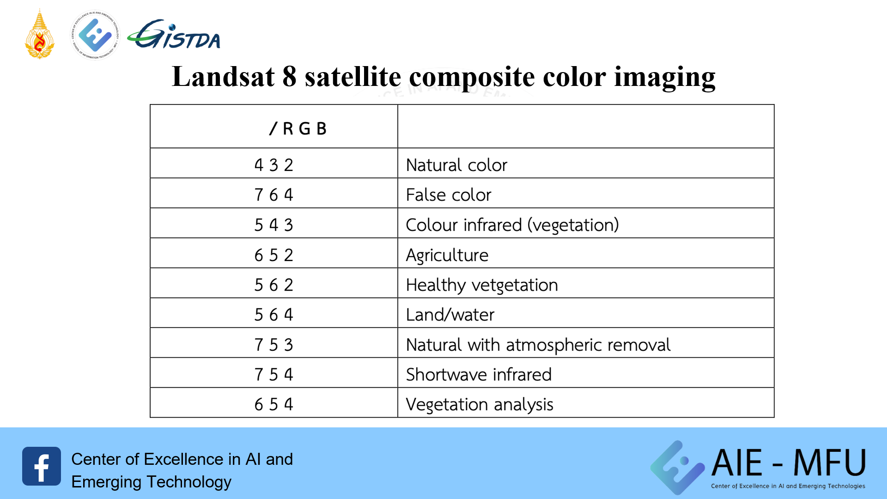
Landsat 8 satellite composite color imaging
Band
Feature
Center of Excellence in AI and Emerging Technology

Slide 17
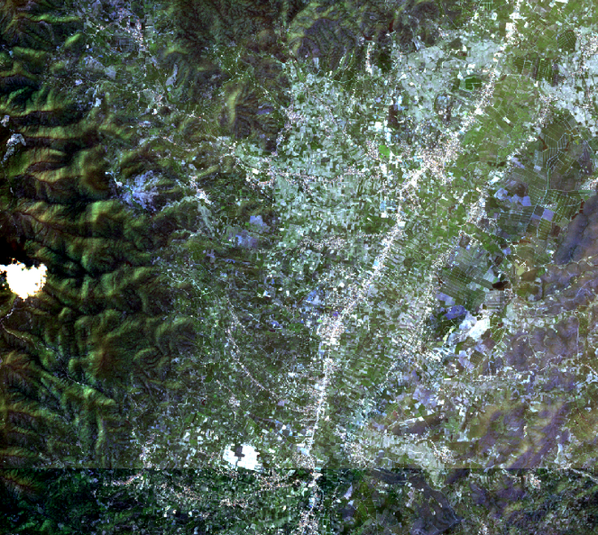
Example of Landsat-8 color combination
Color mixing using satellite images Band 2, Band 3, and Band 4 in the blue, green, and red wavelengths, respectively, with the blue wavelength at 0.45-0.51 μm. The green wavelength is 0.53- 0.59 μm and the red wavelength is 0.64-0.67 μm, which corresponds to the range of white light or the range of light visible to the human eye. Make the result a natural color.
Center of Excellence in AI and Emerging Technology

Slide 18
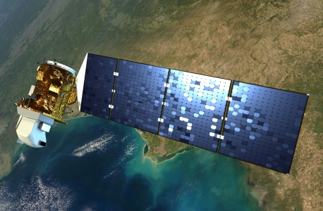
Purpose of the Landsat 8 mission
Landsat 8 consists of 3 main missions and objectives
It collects and archives medium-resolution multi-spectral imaging data covering seasonal areas of the world.
Ensure that Landsat-8 data is sufficiently consistent with data from previous Landsat missions in terms of acquisition geometry. Coverage characteristics calibration Spectral characteristics Product quality and information availability
Ensure that the product is available for download within three hours.
Center of Excellence in AI and Emerging Technology

Slide 19
Current benefits of using the Landsat 8 satellite
Mapping with satellite imagery
Due to the current conditions of continuous changes in the earth's surface and changing every day, maps need to be improved or re-produced to be consistent with the objectives of various users.
Use to assess and investigate disaster occurrences
As our world is changing more and more with various types of disasters such as forest fires, droughts and others, the advantage of all resource observation satellites is that they have the frequency and quantity of data to be collected. It's a huge amount, making it possible to see and verify changes. Therefore, it is applied in various disaster situations.
Use to monitor changes in land use and land cover (Land Use/Land Cover: LULC)
The ability of satellites to collect data continuously over a long period of time allows them to clearly compare differences that occur on the Earth's surface.
Center of Excellence in AI and Emerging Technology

Slide 20
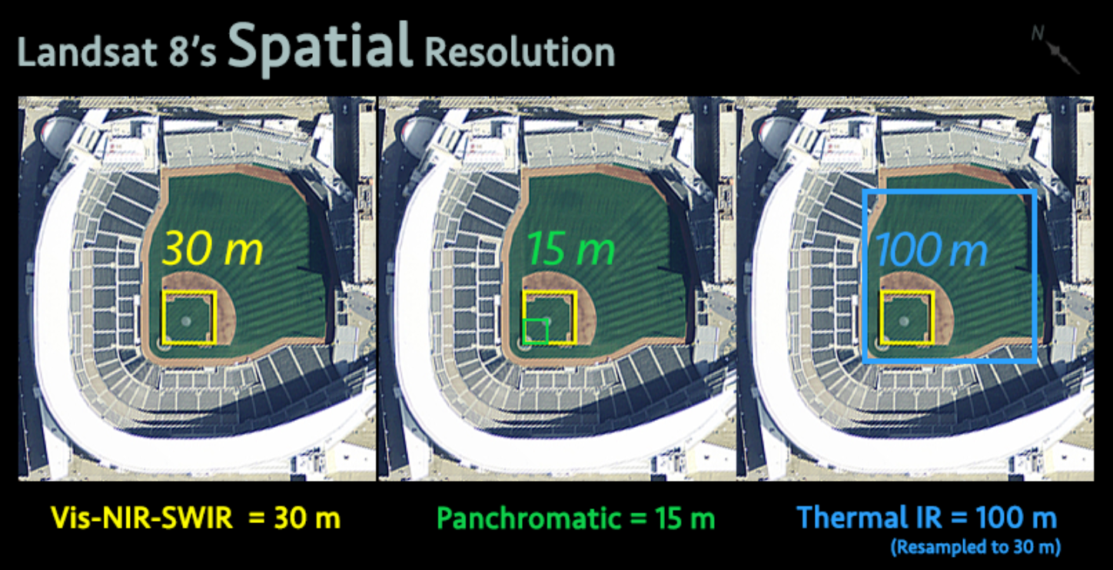
Center of Excellence in AI and Emerging Technology

Slide 21
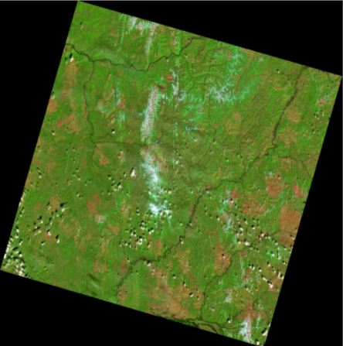
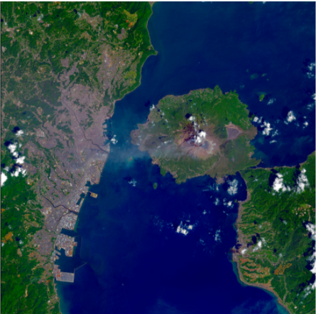
Sample images from LANDSAT-8 satellite
Center of Excellence in AI and Emerging Technology

Slide 22
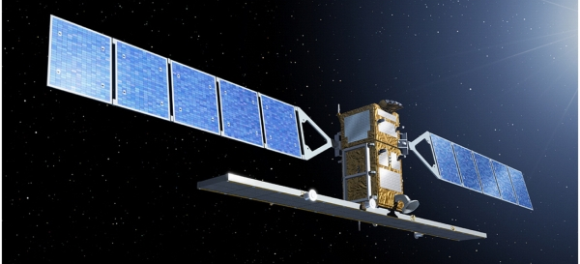
Sentinel-1 satellite
It is the first of the Copernicus project, a satellite constellation operated by the European Space Agency. The mission consists of two satellite constellations, Sentinel-1A and Sentinel-1B, which share the same orbital plane. They have a C-band synthetic aperture radar instrument which collects data in all weather conditions, day and night. The instrument has a spatial resolution down to 5 m and a maximum azimuth of 400 km. The constellation is on a Sun-synchronous orbit, near the poles (98.18°). The orbit repeats every 12 days and completes 175 orbits per cycle.
Characteristic
Sentinel-1 satellite specifications
Lifespan: 7 years (12 years for consumables)
Launcher: Soyuz
Near-polar orbit (98.18°) Sun-synchronous orbit.
Height 693 km (431 mi)
Repeat cycle 12 days
175 cycle per cycle
Orbital period: 98.6 minutes 3-axis altitude stabilization
2,300 kg (5,100 lbs)
Center of Excellence in AI and Emerging Technology

Slide 23

Purpose of the Sentinel-1 satellite mission
Land inspection of forests, water, soil and agriculture
Supports emergency mapping in case of natural disasters
Monitoring the marine environment
Observing sea ice and tracking icebergs
Production of high-resolution ice charts
Forecasting sea ice conditions
Oil leak map
Marine ship detection
Monitoring climate change
Center of Excellence in AI and Emerging Technology

Slide 24


Types of photos from Sentinel-1
Level-0 Raw
Level-1 Single Look Complex
Level-1 Ground Range Detected
Level-2 Ocean.
Center of Excellence in AI and Emerging Technology

Slide 25
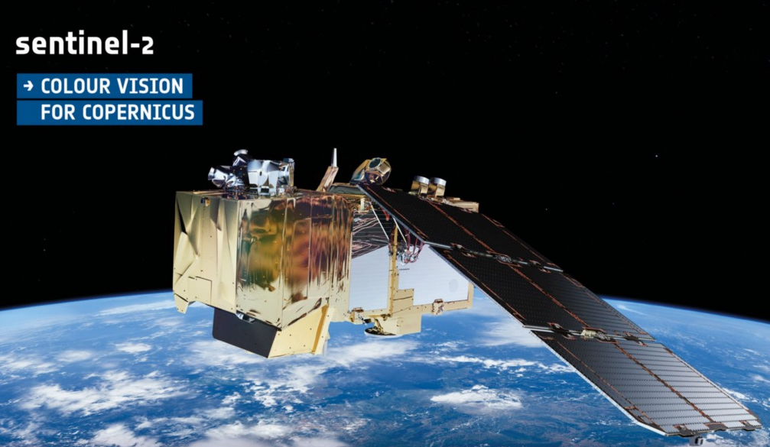
Sentinel-2
Sentinel is a resource survey satellite project of the EU Copernicus Program. The sentinel2 project is operated under the supervision of the European Space Agency. Currently, there are 2 satellites that collect survey data together: Sentinel-2A (launch 2015) and Sentinel-2B (launch 2017). Sentinel image data recording system supports 13 MS frequency bands of visible, near-infrared, and short wave infrared High spatial resolution (10-60 m) image data, which has an area of operation covering all over the world on both land and ocean. It supports data re-logging every 5 days. Sentinel is developed to support applications such as agriculture, resource surveys, disaster management, water resources management, and more.
Center of Excellence in AI and Emerging Technology

Slide 26
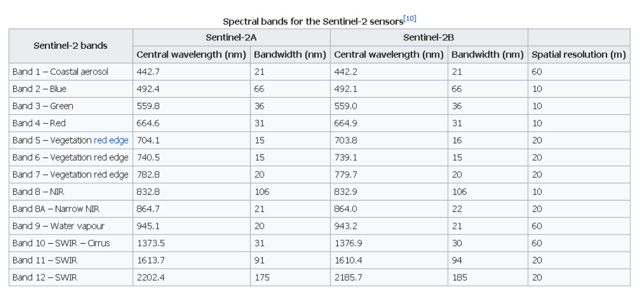
Spectral bands of Sentinel 2A and 2B
Center of Excellence in AI and Emerging Technology

Slide 27
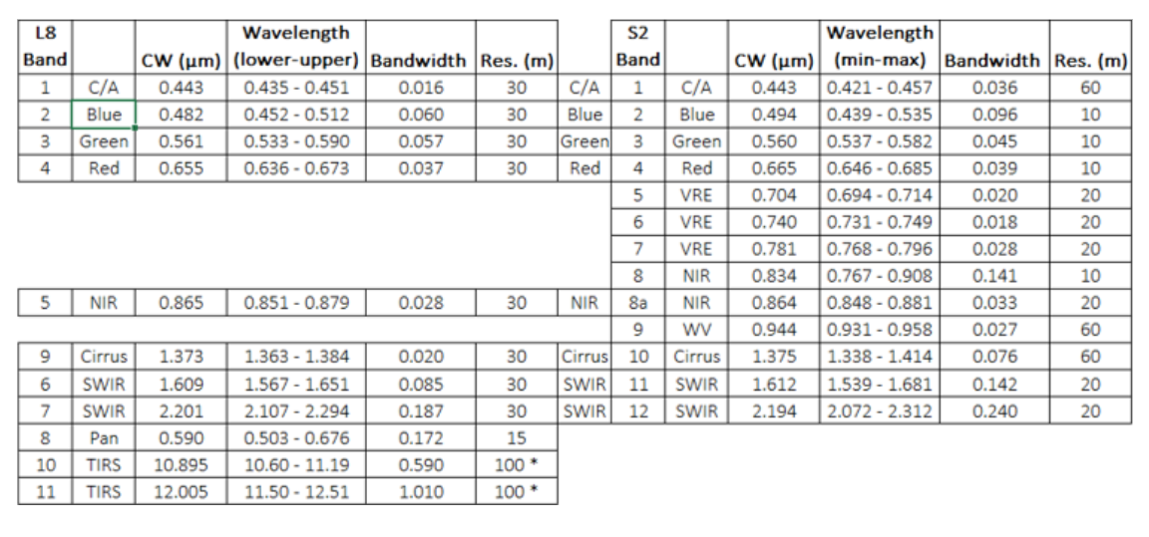
Comparison table of spectral bands of Landsat-8 and Sentinel-2
Center of Excellence in AI and Emerging Technology

